Slide 1

SELFPRIESTEEM SCHOOL OF ETIQUETTE
KIDS ETQUETTE OLINE PROGRAM

Slide 2
KIDS ETIQUETTE ONLINE PROGRAM (6-12)
Our weekly Zoom Room lessons teach your children etiquette skills that build confidence, social awareness and polish.

Slide 3

SELFPRIESTEEM is excited to share our Kids Etiquette Online Program, we warmly welcome all children aged 6-12 years to learn good manners, social skills and everyday etiquette via Zoom Room.
This Photo by Unknown author is licensed under CC BY-SA-NC.

Slide 4
Our online programme consists of a daily 30 minute session, delivered over three consecutive days.
Day 1: first impressions, everyday manners, introductions, positive posture and body language
Day 2: table and dining etiquette
Day 3: grooming and hygiene, voice and articulation, conversations and presentation skills

Slide 5
Worksheets are provided via email for each lesson.
Zoom links are sent the day prior, each week.
Please make sure your child’s screen is set up so students are able to stand in front of the screen from the waist up (this is important for our posture class).
Please set your child up somewhere in the house where there will be no distractions, it is extremely beneficial to minimise background noises. Noises can be very distracting for all students attending the programme.
Please make sure your child has a pen/pencil and paper with them along with the printed activity sheets for each lesson.
We will be having lots of fun during the learning and students will be given some practice exercises after each session.

Slide 6

COST OF 3 DAY ONLINE PROGRAM
$130 per child,

Slide 7
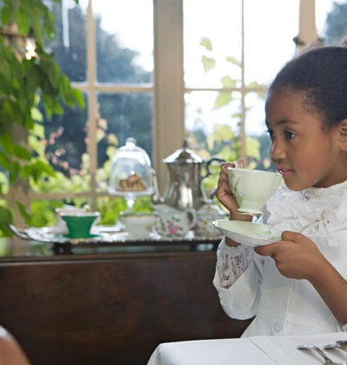
Should the dates of Selfpriesteem online etiquette school holiday program not suit your family, we also offer 1:1 coaching with our Director, Gillean Stone. Click here to enquire.

Slide 8
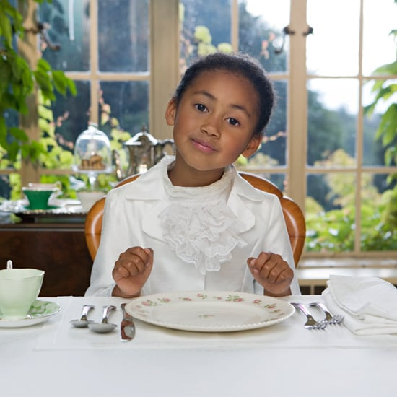
DON'T WAIT TO BOOK AS SPOTS are limited
Each child will be posted a certificate upon completion, all information and worksheets will be emailed prior to course commencement.
Our Zoom Room classes are kept uniquely small to enable positive interactions and great participation for activities and learning.

Slide 9



